Slide 1
NE 763: Advanced Reactor Materials
Fall 2025
Dr. Benjamin Beeler

Slide 2
Last Time
Intro to molten salts
Salt reactor designs
  Salt Cooled Reactor, Flowing Salt Fueled Reactor, Static Salt Fueled Reactor
Benefits of salt reactors
  operate close to atmospheric pressure, negative reactivity feedback coefficient, fission gas behavior, higher temperatures
Requirements for fuel salts
  low neutron absorption, good thermal properties, high stability, low melting point, high boiling point, low vapor pressure, etc.
Add other salts to target certain properties
  lower melting point, reduce viscosity, getter oxygen, etc.
Chlorides vs Fluorides
  fluorides more for thermal, chlorides more for fast

Slide 3
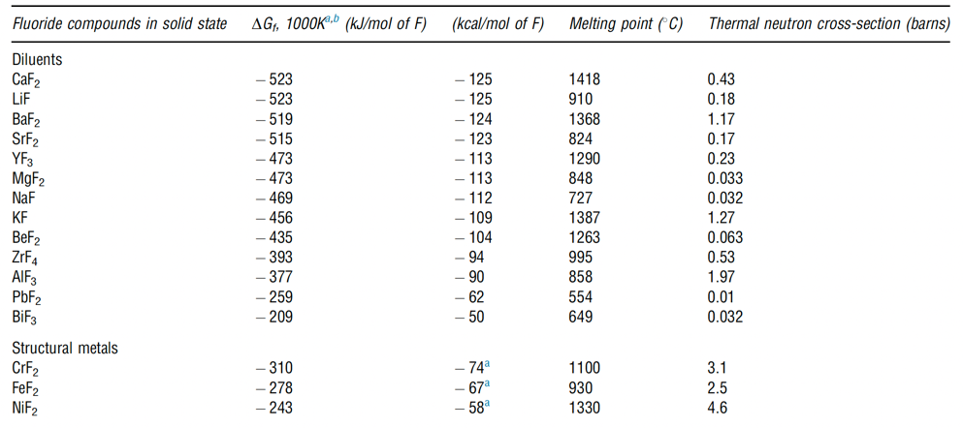
Solution Species
Solute species serve to lower the melting point, and can dually serve as an oxygen getter
Must have low neutron absorption cross section and be chemically compatible with cladding
BeF2, LiF, ZrF, and NaF are commonly utilized due to the combination of these properties

Slide 4
Fuel Salt Classes
Thermal spectrum reprocessing-optimized fluoride salts
  FLiBe (⁷LiF-BeF₂) and NaF-ZrF₄
  FLiBe produces tritium, while NaF-ZrF₄ has a higher vapor pressure
Fast spectrum and thermal spectrum, once-through fuel cycle optimized fluoride salts
  LiF-ThF₄-UF₄-(TRU)F₃
  Much higher fissile loading (actinide-rich eutectics)
  Adequate fissile material content is a significant design challenge
Chloride salts
  Enables harder neutron spectrum and enhanced breeding
  Isotopically separated chlorine preferable - ³⁵Cl from ³⁷Cl, due to moderate capture cross section of ³⁵Cl

Slide 5
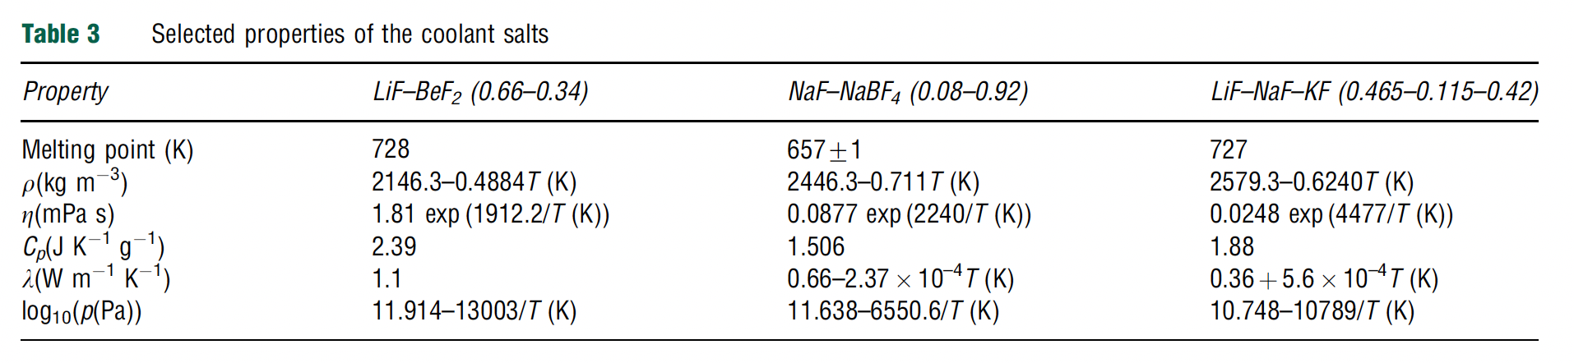
Coolant Salts
Coolants have the same requirements as fuel salts, but without the consideration of fission product solubility, and a higher focus on chemical compatibility and thermal properties
Some secondary systems also consider nitrate salts, such as NaNO3 and KNO3 or a mixture of the two, often referred to as solar nitrate; or fluoroborates such as NaF-NaBF3

Slide 6
Fluorides or Chlorides
Fluoride fuel salts have substantially more experimental data than chloride fuel salts, primarily due to history of MSRs in the thermal spectrum
Fluorides have been operated in molten salt reactors, been tested in multiple in-pile loops, with many capsule tests
Chloride salts have a history of laboratory measurements of physical properties, but no in-core testing of fuel salts
  have extensive use in pyro-processing
Chlorides typically have lower melting points, which is preferable

Slide 7
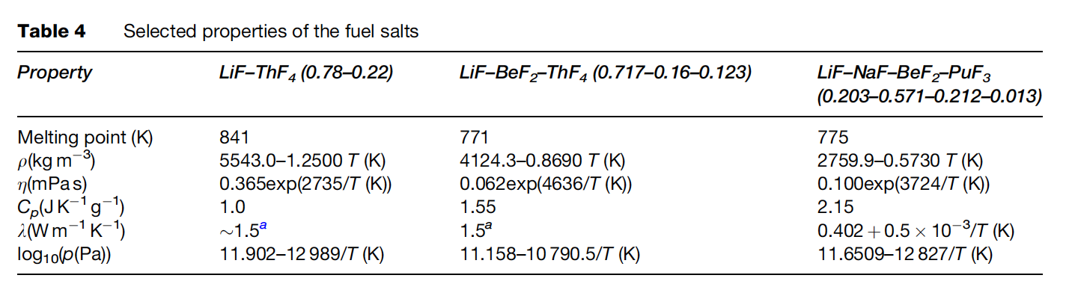
MSR Fuel Candidates
The fuel in the MSR must fulfill several requirements with respect to its physical and chemical properties
These include low melting point, high solubility of relevant species, low viscosity, high heat capacity, high thermal conductivity, low volatility/vapor pressure, neutron transparency

Slide 8
Neutron Economy
Thermal spectrum molten salt fuels were identified as candidates for breeding (converting fertile into fissile), specifically in the thorium fuel cycle
Li-Be-F salts were selected because of the low thermal neutron cross sections of ⁷Li (σ_{th} = 0.045 b) and Be (σ_{th} =0.0088 b)
Natural lithium cannot be used as part of the nuclear fuel as it contains about 7.6% of ⁶Li (the remaining 92.4% is ⁷Li), which has a very high parasitic neutron capture cross-section (σ_{th} = 940 b)
Therefore, enrichment of ⁷Li is required before it can be used in the core
Tritium production can become a problem without enrichment

Slide 9
Fast Spectrum MSRs
Current MSR designs move away from thermal graphite-moderated concepts, and favor non-moderated concepts that have a fast(er) neutron spectrum and can function to burn radioactive waste
Fuel selection for the non-moderated reactor concepts is more flexible, and elements other than ⁷Li can be considered
The neutron capture cross-section of the alkali halides and alkali-earth halides is generally lower in the fast spectrum than in the thermal spectrum
Compounds like NaF, KF, RbF, or CaF2 can be considered as part of the fuel matrix
There are also some fast MSR concepts which are based on chloride salts

Slide 10
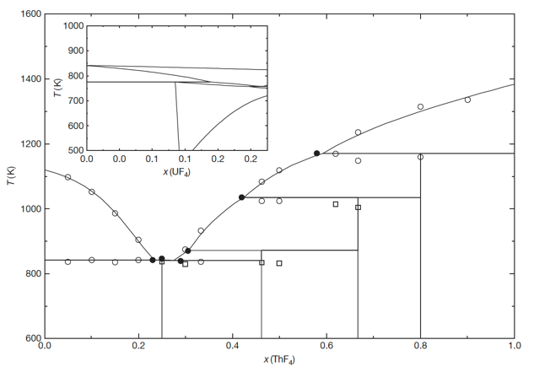
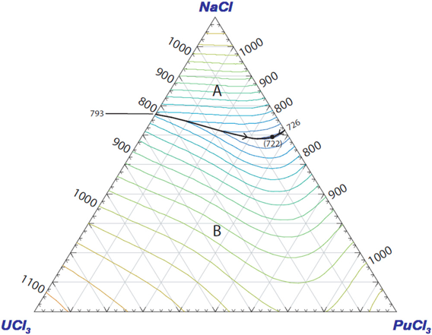
Solubility
The solubility of ThF4 in a matrix of LiF can be deduced from the binary phase diagram
For example, the solubility of ThF4 in a melt of LiF for T~903K (inlet temperature of the MSFR) is between 20.0 and 32.3 mol%
Compositions in this range are, thus, of interest as fuel for MSRs
Similarly, eutectic composition and melting temperature are key factors that govern the utilization of specific salts
Many fission products will form some kind of salt species, with varying degrees of solubility

Slide 11
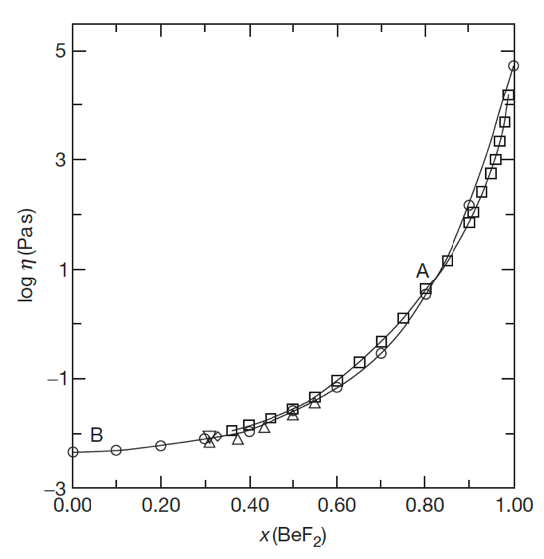

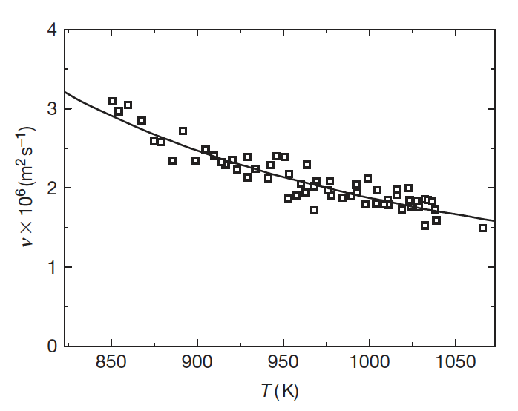
Low Viscosity
The viscosity of a fluid is a measure of its resistance to deformation at a given rate; conceptualized as the internal frictional force that arises between adjacent layers of fluid that are in relative motion
Lower viscosity results in less force to move the fluid at a given velocity
It is sometimes more convenient to utilize the kinematic viscosity, defined as the ratio of the dynamic viscosity μ (or η) to the density of the fluid ρ
The viscosity of fluoride systems shows significant non-ideal mixing behavior
Thus, it is not possible to accurately estimate the viscosity of the fluoride salts from its constituents, and therefore more measurements are required

Slide 12
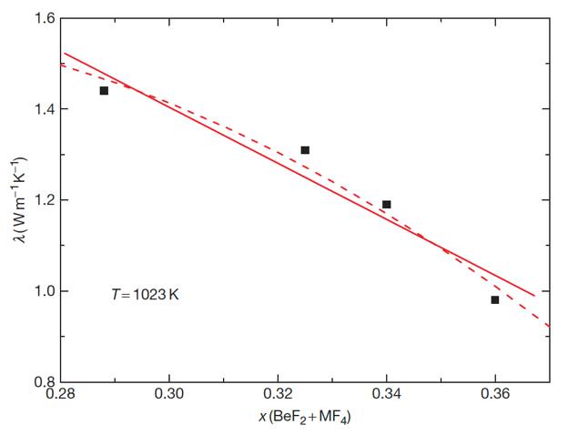
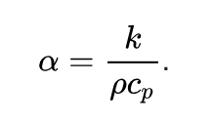
Heat Capacity and Thermal Conductivity
Heat Capacity is defined as the amount of heat to be supplied to an object to produce a unit change in its temperature
High heat capacity enables a small amount of the refrigerant to transfer a large amount of heat very efficiently
While salts have good heat capacity, data on experimental heat capacity and thermal conductivity of molten fluoride systems containing actinide fluorides are generally lacking
The thermal conductivity of a material is a measure of its ability to conduct heat
High thermal conductivity and thermal diffusivity will increase the rate of heat transfer through the fluid

Slide 13
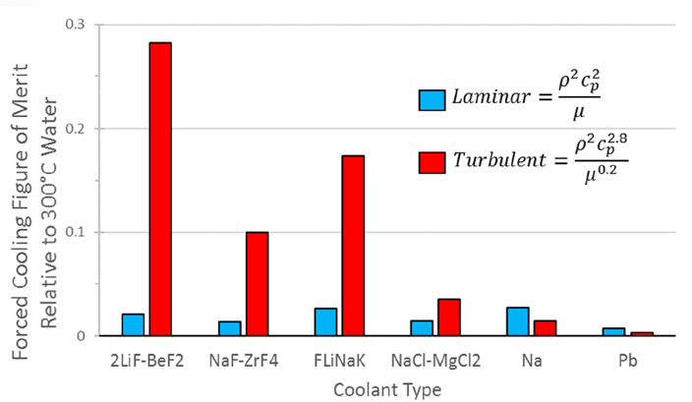
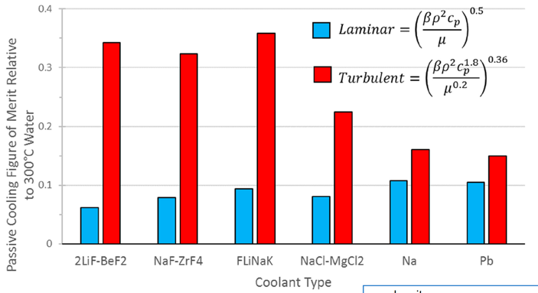
Heat Transfer
Large heat capacity and low viscosity are key properties allowing good heat transfer in molten salts
In both forced flow and passive cooling conditions, molten salts outperform liquid metals in turbulent flow for heat transfer
However, experimental data for heat transfer is still significantly scattered for the range of relevant MSR conditions

Slide 14
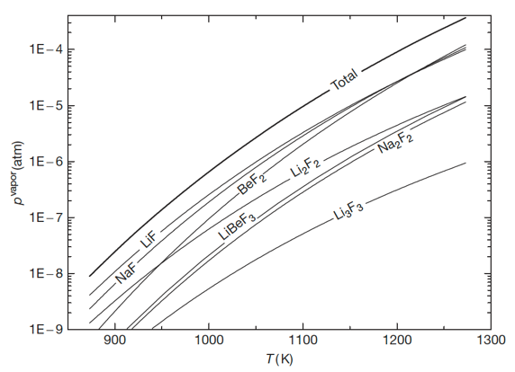
Vapor Pressure (Volatility)
Volatility is a material quality which describes how readily a substance vaporizes
A substance with high volatility is more likely to exist as a vapor, while a substance with low volatility is more likely to be a liquid or solid
Vapor pressure is a measurement of how readily a condensed phase forms a vapor at a given temperature
High vapor pressures indicate a high volatility, while high boiling points usually indicate low volatility
Salts should have high boiling and low freezing points, in addition to a low vapor pressure (low volatility)

Slide 15
Chemical Compatibility
For any high-temperature application, corrosion of the metallic container alloy is a primary concern
The products of oxidation of metals by molten salts tend to be completely soluble in the corroding media
Due to this solubility, passivation is precluded, and the corrosion rate depends on other factors, including oxidants, thermal gradients, salt flow rate, and galvanic coupling
Examination of the free energies of formation for typical alloy components shows that chromium is the most active metal component
Thus, any oxidative attachment to these alloys should be expected to show selective attack on the chromium
Stainless steels, having more chromium than Ni-based alloys, are more susceptible to corrosion by fluoride melts

Slide 16



Role of Oxygen Impurities
The behavior of these systems can be significantly affected by the presence of the oxygen that might be resulting from contamination of the salt system
Actinide oxides, such as UO2, can precipitate out for oxygen concentrations as low as 1E-4
Metal oxides have much higher melting points and therefore appear as insoluble components at operating temperatures
Oxygen also plays a key role in corrosion processes
ZrF4 was implemented as an oxygen getter in the original MSRE fuels
AlCl₃ or CCl₄ can also be used as reactants to tie up oxygen, or strip O from UO2

Slide 17
Control of Chemistry
Avoiding corrosion in an MSR or in fuel-processing units with metallic components is significantly more challenging than avoiding corrosion in clean salt coolant applications
The dissolved uranium and other such species in the fuel salt result in the presence of additional corrosion mechanisms
In clean salt applications, these types of corrosion mechanisms can be reduced or eliminated by (1) using purified salts that do not contain chemical species that can transport chromium and other alloy constituents or (2) operating under chemically reducing conditions
Redox control could be accomplished by including an HF/H₂ mixture

Slide 18
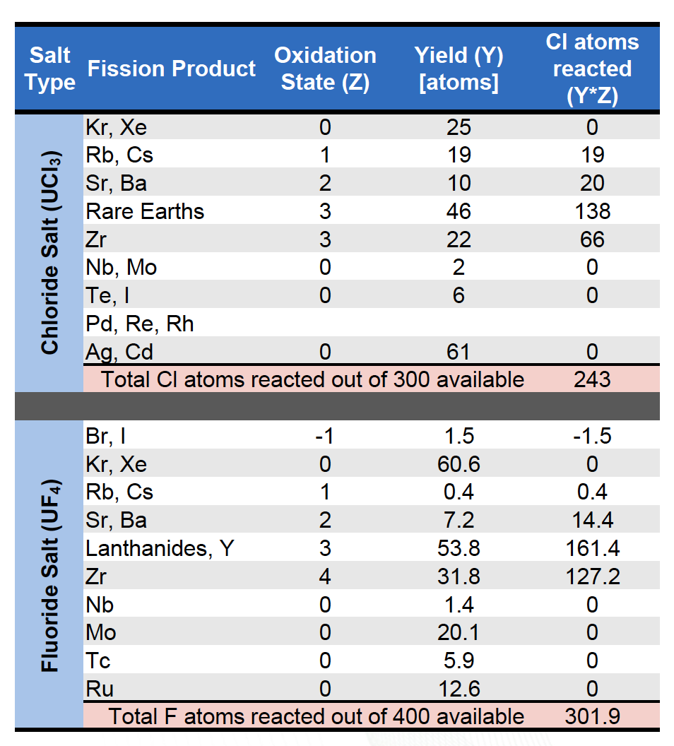
Changes During Fission
The redox potential is a measure of the tendency of a chemical species to acquire electrons from or lose electrons and thereby be reduced or oxidized
The fission process continuously alters the fuel salt redox conditions
When a U or Pu ion fissions, the available electrons will rearrange on each fission product to satisfy its valence requirements and produce either net oxidizing or reducing conditions in the melt
For UF4, four F ions are released; often fission products require less than four and thus there will be an excess of F ions with net oxidizing conditions

Slide 19
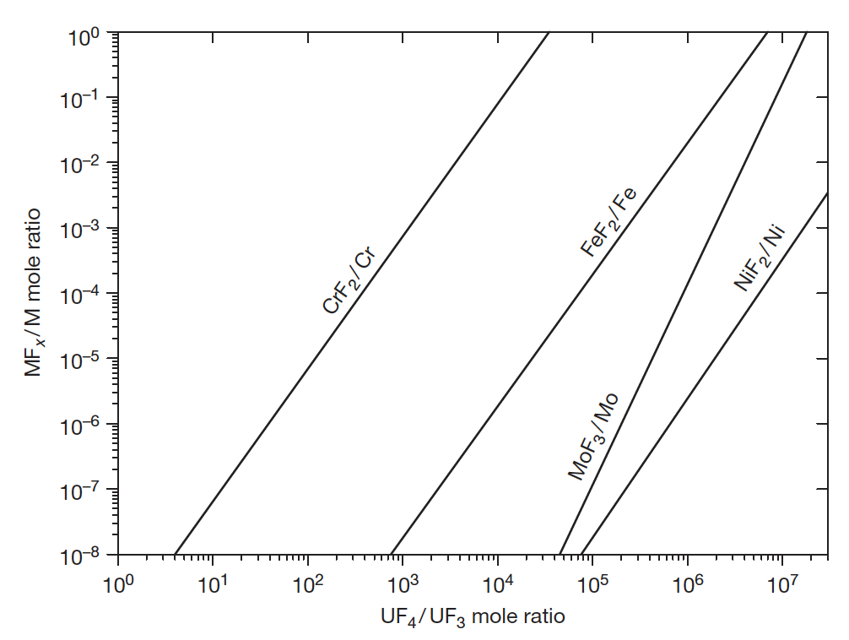
Maintaining Reducing Redox Conditions
Maintaining mildly reducing redox conditions is the key to enabling use of engineering alloys
Use of a circulating redox buffer provides means to maintain redox condition, while the oxidation states are changing due to fission
The ratio of U4+/U3+ serves as a measure of the redox potential of the salt for both chlorides and fluorides
Bottom right is the variation of equilibrium concentration of structural metal fluorides as a function of the UF4/UF3 ratio in a molten salt reactor fuel
Too high values lead to corrosion of structural materials; too low values lead to formation of UC phases from the graphite

Slide 20
Fission Products
Distribution of fission products is a central safety issue
Fission products may be gaseous, solid, or dissolved
Alkali and alkaline earth fission products form stable salts – Rb, Cs, Sr, Ba
Lanthanides and some transition metals can form stable salts
Semi-noble fission products plate out on metal surfaces – Nb, Mo, Tc
A few elements are very sensitive to redox changes
May elect to actively remove gaseous fission products, but requires cooling fission product traps
  Lowers the in-core accident source term
  Prevents bubble formation and collapse, which results in reactivity jumps

Slide 21
Fission Product Plating
Noble metals are insoluble in the fluoride salt and can be found in helium sparge gas, on the graphite, or deposited on the metallic surfaces of the primary circuit
The deposited material contributes to the heat generation from its decay even after the reactor shutdown, decreasing the overall safety of the MSR
The deposits on the graphite (in the case of thermal reactors) absorb neutrons during the operation and lead to lower efficiency of the reactor
One way of avoiding this detrimental precipitation is to remove the insoluble fission products by helium bubbling before they interact with the structural materials

Slide 22
Cover Gas
The cover gas (off-gas) handling system is a key element of any MSR
Fission gases such as xenon and krypton will readily escape the salt
Acidic gases may accumulate as a result of radiolysis
Tritium is formed by neutron interactions with light elements in the salt
The cover gas system will contain the radionuclides emerging from the free surface above the fuel salt as well as any sweep or sparging gases used

Slide 23
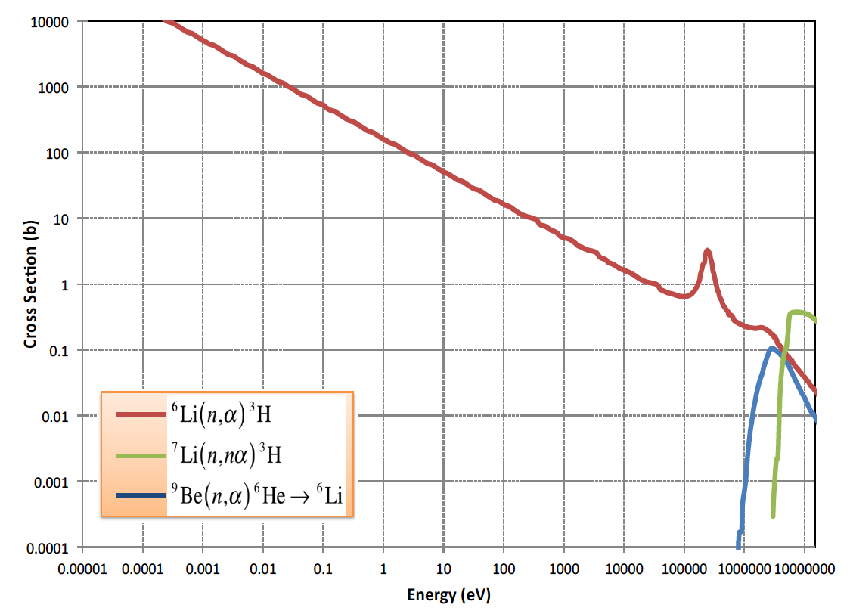
Tritium
Tritium production and control is an issue for Li-bearing salts
Tritium is produced by neutron reactions with lithium, beryllium, and fluorine as well as being a ternary fission product
Tritium can exist as ions or as TF, depending on redox conditions
Above 300C tritium will diffuse through structural materials

Slide 24
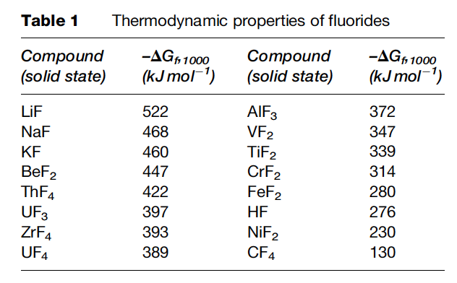
Radiolytic Stability
Radiolysis is the dissociation of molecules by ionizing radiation
Molten salts are highly radiolytically stable
Salts are combinations of strongly electronegative elements with strongly electropositive metals with very high bond energies
Formation energy of alkali/alkaline salts is more negative than metal fluorides

Slide 25
Three principal corrosion processes
Reactions due to oxides on the metal
Reactions with dissolved impurities
Reactions with necessary constituents of the melt

Slide 26
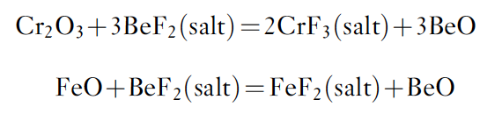
Protective coatings?
It is not useful to apply a protective coating of, for example, an oxide layer on the structural material for the two following reasons:
  although some oxides are relatively insoluble in the fluoride melt, most are readily dissolved
  all oxides rapidly recrystallize
Oxide films on the surface of the alloy can be attacked by the fluoride melt
The formed oxides (BeO below) typically don’t matter as long as they do not contain fissile elements
The formed fluorides are more important as they will act as oxidants of Cr in the alloy

Slide 27
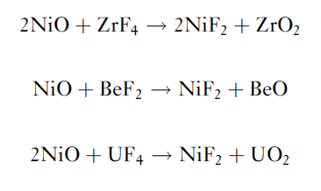
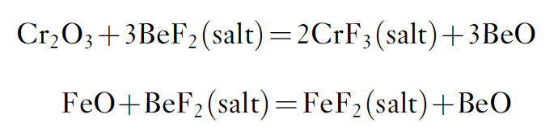
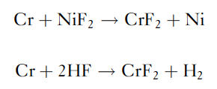
Oxides and Impurities
Structural materials will have been exposed to air, and thus have oxide films
Oxide films on the metal are dissolved, leading to cladding constituent fluorides
Other corrosion reactions are possible with solvent components
Such reactions can lead to rapid initial corrosion
These impurity reactions can be minimized by maintaining low impurity concentrations in the salt and on the alloy surfaces

Slide 28
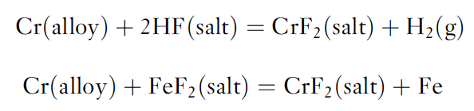
Dissolved Impurities
In addition to impurities generated by reactions with oxides, impurities may result from incomplete removal of HF or of easily reducible fluorides during the salt purification

Slide 29
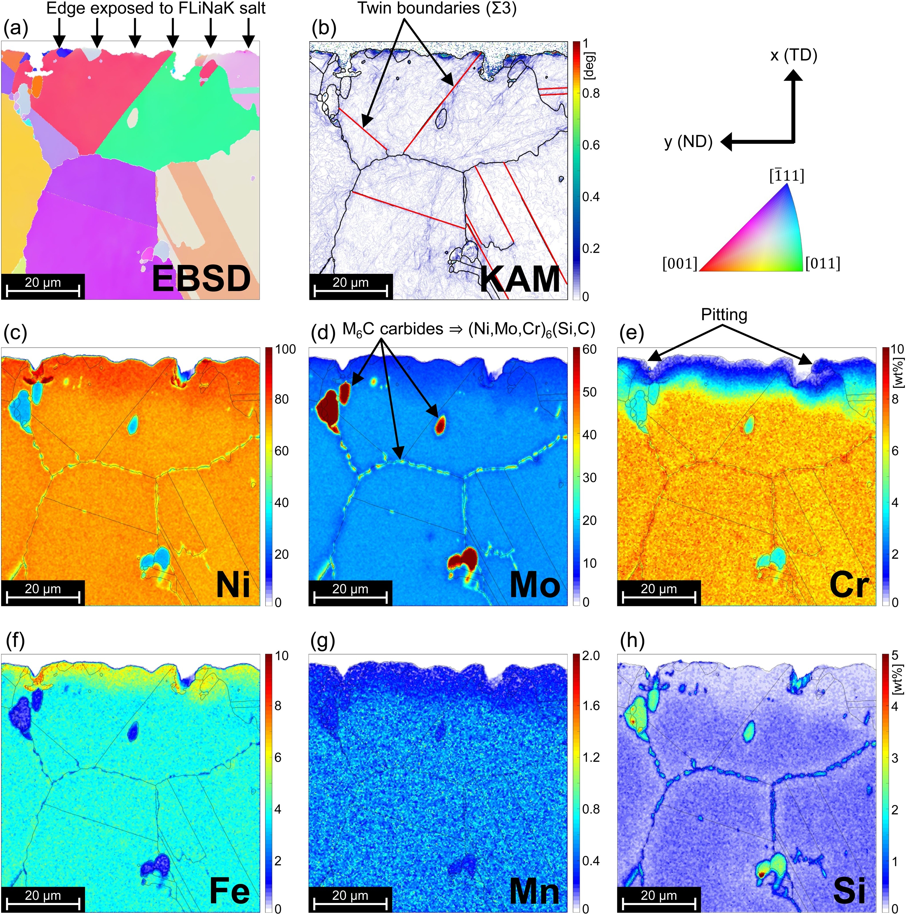
Cr ‘Oxidation’
Redox processes responsible for attack by fluoride mixtures on the alloys result in selective oxidation of the contained Cr
This removal of Cr from the alloy occurs primarily in regions of highest temperature
The rate of corrosion has been measured and was found to be controlled by the rate at which chromium diffuses to the surfaces undergoing attack
https://doi.org/10.1016/j.corsci.2019.108306

Slide 30
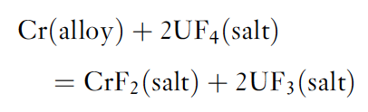
Constituents of the Melt
The oxidation reaction of alloy components with UF4 has been suggested to play an important role in corrosion
The equation will define/buffer the electrochemical potential of the salt via the UF4/UF3 ratio
Excess fluorine liberated via fission increases fluorine potential, forming more UF4 and increasing corrosion rates
Based on reasonable estimations of the activity coefficients for the above reaction, the equilibrium concentration of CrF2 is of the order of 130–300 ppm for a fuel with 1% UF3 contained in Hastelloy-N

Slide 31
Pause and Recap
Excess fluorine generated through fission increases the redox potential
Some fission products will form fluorides, some will exist as gases, some as metals
Cover gas serves to remove gaseous species and He bubbling with particle traps remove precipitates
Corrosion occurs through reactions with oxides on the metal, with dissolved impurities, and with salt constituents
Oxides dissolve in salt, leading to generation of metal fluorides
Cr->CrF2 is most likely structural material reaction and dictates the maximum redox potential
UF4/UF3 ratio is the proxy for redox potential, and should be kept at ~100

Slide 32
Materials for MSR systems
The materials required fall into three main categories: (1) metallic components for primary and secondary circuits, (2) graphite (or other structural steels) in the core, and (3) materials for molten-salt fuel reprocessing systems
The metallic material used in constructing the primary circuit of an MSR will operate at temperatures up to 700–750C
Operating lifetime of 30-50 yrs, with fluences of up to 8x10²¹ n/cm²
The metal must have moderate oxidation resistance, must resist corrosion by the salt, and must not be subject to severe embrittlement by neutrons
The material must shapeable, with wall thicknesses from >1cm to less than 1mm, and weldable

Slide 33
Metallic Materials for MSR systems
Fairly extensive literature exists on corrosion of metal alloys by molten fluorides in convection or forced flow loops
Limited experimental efforts on irradiation-combined corrosion effects
Nickel-based and austenitic stainless steels were primarily investigated
General knowledge:
Corrosion is associated with outward diffusion of Cr through the alloy
Corrosion rate is marked by initial rapid attack associated with dissolution of Cr and is largely driven by impurities in the salt
This is followed by a linear corrosion rate which is controlled by mass transfer

Slide 34
Metallic Materials for MSR systems
General knowledge:
Minor impurities in the salt can enhance corrosion by several orders of magnitude
Dissolution can be mitigated by a chemical control of the redox conditions in the salts
Stainless steels, Inconel 600, Hastelloy-B, and Hastelloy-W were explored, but either excessively corroded or had poor aging properties
Hastelloy N was developed with a composition of Ni–16%Mo–7%Cr–5%Fe–0.05%C
Limited Cr is included to impart moderate oxidation resistance in air, but not high enough to lead to high corrosion rates in salt
Hastelloy N has excellent corrosion resistance to molten fluoride salts at temperatures considerably above those expected in MSR service

Slide 35
Metallic Materials for MSR systems
Problems with Hastelloy-N
Is subject to irradiation hardening due to accumulation of He at grain boundaries
This is potentially mitigated through alloys with fine carbide precipitates to trap He
Tiny cracks formed on the inside surface of Hastelloy-N piping for the MSRE
Intergranular cracks were due to Te, which can likely be controlled with appropriate redox conditions
Additions of Ti can aide in fine carbide precipitates, and additions of Nb can limit Te cracking
No alloys with both additions have been studied, but it is supposed that additions of 1% Ti and 1% Nb can sufficiently solve both problems

Slide 36
Tellerium
When Te is present in the metallic form in the fuel, it corrodes Ni-based alloys and embrittles its surface grain boundaries
Embrittlement is a vital issue to consider because it can result in cracking of the structural materials
This intergranular embrittlement produced in Hastelloy-N can be significantly reduced by adding 1–2 wt% of niobium into the Hastelloy-N
Another way to suppress the corrosion rate is by increasing the reducing conditions of the fuel, which is done by the decreasing the UF4/UF3 ratio
This allows Te to be present as Te⁻² rather than in an ‘oxidized’ metallic form, and this is less aggressive against the nickel-based alloys

Slide 37
Materials for MSR systems
Focus on graphite core
Graphite is the principal material other than salt in the core of the reference breeder reactor design with a thermal spectrum, or used as a reflector in fast designs
The graphite structures will operate in a fuel salt environment over a range of temperatures from 500 up to 800C
There are two main requirements in the graphite in MSRs: that both molten salt and xenon be excluded from open pore volume
Significant penetration of the graphite by the fuel salt would generate a local hot spot, leading to enhanced radiation damage to the graphite and perhaps local boiling of the salt

Slide 38
Graphite for MSR systems
Extensive experimental work has demonstrated the compatibility of graphite with molten salts
Graphite undergoes the same shrinkage/turnaround processes during irradiation
For molten salts, post-turnaround graphite is of concern, due to the increased porosity allowing for salt ingress
This puts a cap on fast neutron fluence in graphite for salt systems at about 3E22 n/cm², which translates into about 3-4 years as a moderator in the MSBR
Graphite needs to be surface-sealed to prevent Xe penetration
¹³⁵Xe can diffuse into the graphite and function as a neutron poison
Pyrocarbon sealing was explored, but led to more rapid turnaround

Slide 39

Graphite Compatibility
Graphite does not react with molten fluoride mixtures of the type to be used in the MSR concepts
After carbon, borides and nitrides appear to be the most compatible nonmetallic materials
Thermodynamic data suggest that the most likely reaction is:
but this should come to equilibrium at very low CF4 pressures
CF4 concentrations over graphite–salt systems maintained for long periods at elevated temperatures have been shown to be below the limit of detection

Slide 40
These materials have been shown to survive!
MSRE graphite and Hastelloy N exposed to coolant salt was clean after 2+ years of operation

Slide 41
Materials for MSR systems
Reprocessing materials
The key operations in fuel reprocessing are (1) removal of uranium from the fuel stream for immediate return to the reactor, and (2) removal fission products from the fuel solvent
One severe corrosive environment in this process includes salt at 550C with F2 and UF6, and so that an average valence of 4.5 exists
Other severe corrosive environment is at 650C with salt containing molten alloys of Bi, Li, Th, etc. with HF-F2 gases
The environment must be an inert gas or a vacuum to prevent deterioration of structural material to ensure long-term service
Typically, Ni or Ni-based alloys have been used for containment

Slide 42
Materials for other Salt Reactor Concepts
AHTR: TRISO particles in graphite compact prismatic core with molten salt coolant
LSFR: solid fueled fast reactor with molten salt coolant
SSR: liquid fueled, non-flowing
Secondary Coolant Loop: may use nitrate, chloride, or fluoroborate salts, with different corrosion
Materials for these systems either experience higher temperatures or higher flux/fluence requirements, and thus Hastelloy-N type materials may not be applicable
Potential options are 9Cr-1MoV coated in Ni, ODS Ni alloys, Ni-based superalloys, ODS Fe alloys, and Mo alloys
Stainless steels can be options for secondary loop

Slide 43
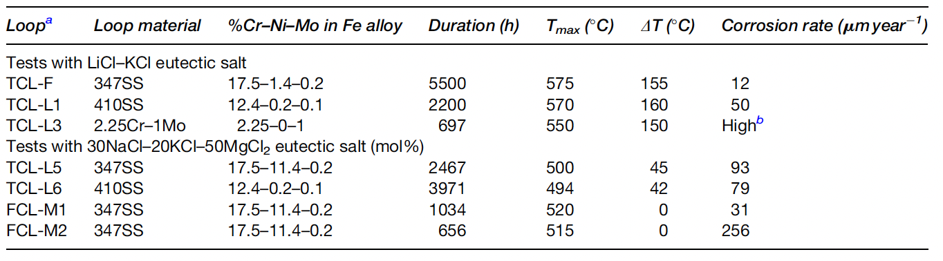
Chloride Salt Corrosion
Very little corrosion data is present for chloride salt systems
Some of the existing data does not conform to expected trends
The effect of chromium content in the alloy may not be as important of a factor, and the effect of temperature is not clear
These corrosion rates are comparable to fluoride salts with stainless steel, and are considerably higher than corrosion rates with Hastelloy-N
Active research is on-going and these statements may be out of date…

Slide 44
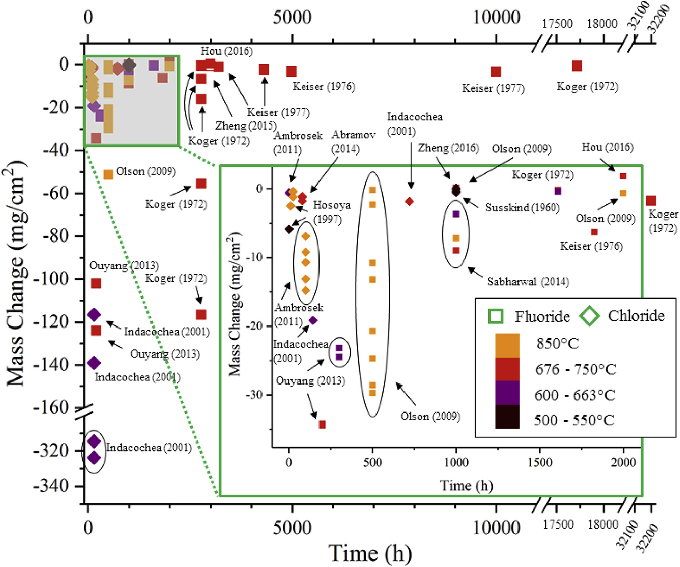
Recent Corrosion Summary
Molten salt corrosion data from studies published in 1960-2016 were aggregated and graphed
Studies were graphed by salt purity, temperature, sample material, container material, and experimental method (loop, capsule, crucible)
Data can be very scattered, and generally limited data, with more corrosion data on fluorides than chlorides
https://doi.org/10.1016/j.jnucmat.2018.07.036

Slide 45
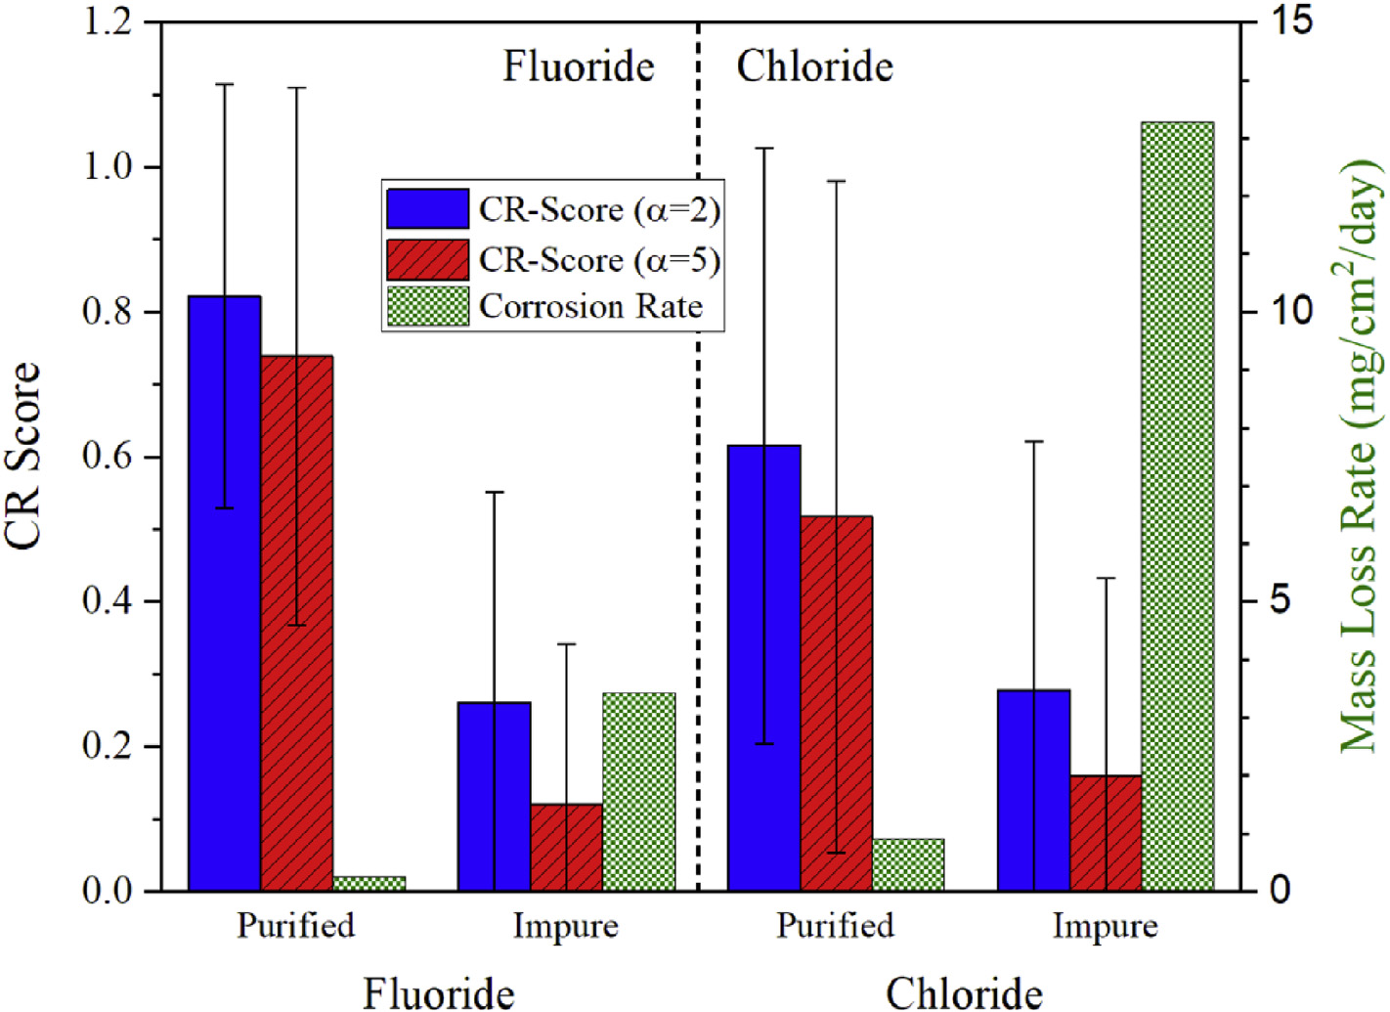
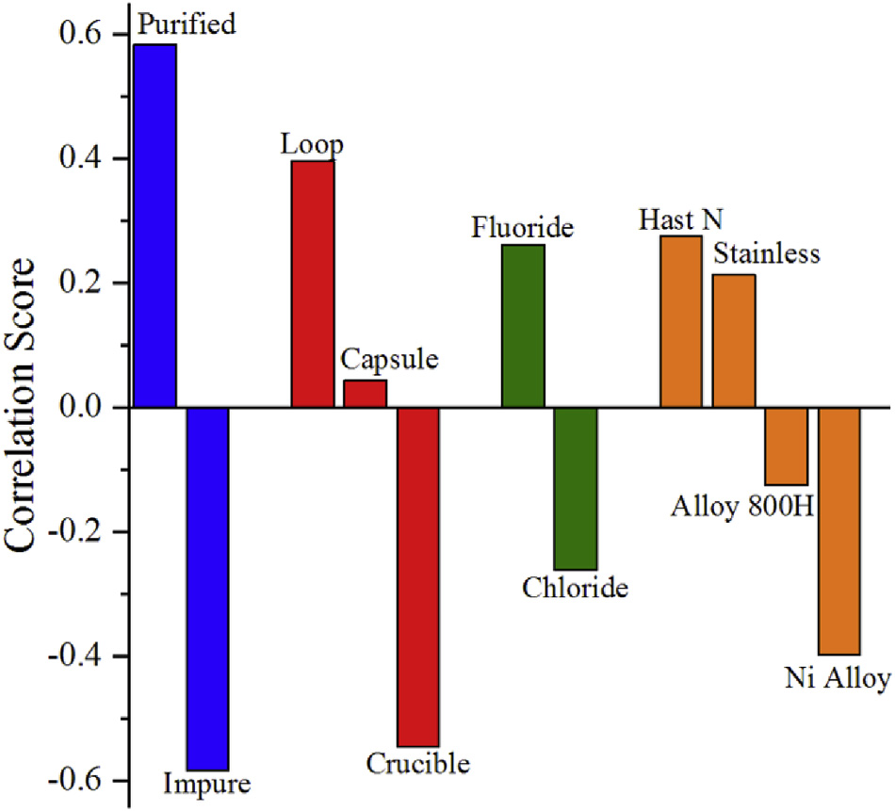
Recent Corrosion Summary
Salt purity was the factor which most affected corrosion rates
Experiment type and salt type (fluoride vs. chloride) following as the next most important factors
Higher CR score = less corrosion; Positive correlation = less corrosion

